Slide 1
Introduction
Devops and continuous delivery using Jenkins, kubernetes and docker

Slide 2



About the instructor
Omri Siri
Age 32
Tel-Aviv
Previously:
Director of operations @ Avantis - a startup in the AdTech industry
Lead DevOPS @ Liveperson
14+ years of Linux experience

Slide 3
Agenda
Introduction to DevOPS and continuous delivery
puppet in a nutshell
Git source code management
CI/CD with jenkins
Docker
kubernetes
Alternatives for Jenkins and git on AWS

Slide 4
Lets begin!

Slide 5
Continuous Delivery + DevOps = Awesome

Slide 6
“IT doesn’t matter.”
-- Nicholas Carr, 2003

Slide 7
IT Does Matter
Times – and IT – have changed
DevOps is good for IT
DevOps is good for Organizations
And then some detail: What drives this change?
Tooling and automation (hint: Continuous Delivery)
Practice and process (hint: Lean Management practices)
Culture and communication

Slide 8
DevOps is
Tooling and Automation implemented as Continuous Delivery, Practices and Processes seen in Lean Management principles, and Organizational Culture
Research shows that these drive IT Performance and Organizational Performance

Slide 9
That was then…
10 deploys per day
Dev & ops cooperation at Flickr
John Allspaw & Paul Hammond
Velocity 2009

Slide 10
This is now…
Amazon Deployment Stats
(production & host environments only)
1,079
10,000
30,000
Max deploys
In a single hour
Every 11.6 seconds!
Mean # hosts receiving
Deploys simultaneously
Max # hosts receiving
Deploys simultaneously

Slide 11
This is now…
Etsy Code Deployment
What once required 6-14 hours and an “Army”
…Now takes 15 minutes and 1 person
30+
50
80-90
Deploys
per day
2013
Deploys per day
March 2014
QCon London
Deploys per day
April 2014
Chef Conf

Slide 12
DevOps is good for organizations

Slide 13
High Performing IT organizations
2x
50%
More likely to exceed
Profitability,
Market share, and
Productivity goals
Higher market cap
growth over 3 years*

Slide 14
Devops is good for IT
Measuring DevOps and IT Performance
Deploy frequency (Note: NOT delivery)
Mean Time to Recover (MTTR)
Lead Time for Changes

Slide 15
High Performing DevOps teams
More agile
30x
200x
More frequent
Deployments
(2015 and 2014)
Faster lead times
than peers
(2015 and 2014)

Slide 16
High Performing DevOps teams
More reliable
60x (2015)
3x (2014)
168x (2015)
48x (2014)
Change
Success
Rate
Faster
Mean time to recovery
(MTTR)

Slide 17
DevOps promises – and delivers More throughput More stability In tandem. Without the tradeoffs that ITIL calls for. Let’s talk about what this means for us

Slide 18
High Performing DevOps teams
More agile What does this mean for:
30x
New content delivery
Value/savings around A/B testing
Value around speed to market
Compliance / regulatory
Security
More frequent
deployments
200x
Faster lead times

Slide 19
High Performing DevOps teams
More reliable What does this mean for:
60x
Value/savings around reliability
Value/savings around uptime
Compliance
Security
Reputation around uptime,
compliance & security
Fewer deploy
failures
168x
Faster MTTR

Slide 20
Evaluating well-designed and executed experiments that were designed to improve a key metric, only about 1/3 were successful at improving the key metric!
Online Experimentation at Microsoft, Kohavi et al http://stanford.io/130uW6X

Slide 21



Slide 22
Key Factors that Correlate with Each Component:
MTTR
Also Super
Important:
Version control for all production artifacts
Monitoring
Lead time for changes
Culture
Job satisfaction
Climate for learning
Version control for all production artifacts
Automated testing
Deployment Frequency
Version control for all production artifacts
Continuous Delivery

Slide 23
We know:
IT Performance is comprised of throughput and stability, and both are possible without tradeoffs
IT Performance contributes to org performance ($$$)
Culture is a key predictor of both IT Performance and Organizational Performance
Automation and tooling are important
So:
What drives IT and Organizational Performance?

Slide 24
DevOps is
Tooling and Automation implemented as Continuous Delivery, Practices and Processes seen in Lean Management principles, and Organizational Culture
Research shows that these drive IT Performance and Organizational Performance

Slide 25
Continuous Delivery practices
Test deployment
& automation
Continuous Delivery
IT Performance
Org Performance
Continuous
integration
All production artifacts in version control

Slide 26
Continuous Delivery in the Data
… the details

Slide 27
What is Test Automation?
Developers primarily create and maintain acceptance tests
When the automated tests pass, I am confident the software is releasable
Test failures are likely to indicate a real defect
It's easy for developers to fix acceptance test failures
Developers share a common pool of test servers to reproduce acceptance test failures
Developers use their own development environment to reproduce acceptance test failures

Slide 28
What is Deployment Automation?
For the primary application or service you work on, what percentage of your deployments are automated?

Slide 29
What is Continuous Integration?
Code commits result in a build of the software.
Code commits result in a series of automated tests being run.
Builds and tests are executed successfully every day.
Current builds are available to testers for exploratory testing.
Developers get feedback from the acceptance and performance tests every day.

Slide 30
What is Version Control?
Our application code is in a version control system
Our system configurations are in a version control system
Our application configurations are in a version control system
Our scripts for automating build and configuration are in a version control system

Slide 31
Continuous Delivery makes our work better
Lower Change Fail Rates
Test & deployment automation
Continuous Delivery
IT Performance
Org Performance
Continuous
integration
All production artifacts in version control

Slide 32

“We never had testability before. We have it now. We have this experience and know this stuff is working, and working with controls.”
– Product Owner for Yahoo Chef implementation
Automated configuration and deployment of 250,000 nodes
Can deploy up to 140k node configurations in 8 hours.
Can patch entire infrastructure within 6 hours of a patch being made available

Slide 33
Continuous Delivery makes our work better… and makes it feel better!
Lower Change Fail Rates
Test & deployment automation
Continuous Delivery
IT Performance
Org Performance
Continuous
integration
All production artifacts in version control
Decreased Feelings of Burnout
Lower Deployment Pain

Slide 34
Continuous Delivery makes our work better… and makes it feel better!
Lower Change Fail Rates
Test & deployment automation
Continuous Delivery
IT Performance
Org Performance
Continuous
integration
All production artifacts in version control
Decreased Feelings of Burnout
Lower Deployment Pain

Slide 35
But what else drives IT Performance?
Lean Management
IT Performance
Org Performance

Slide 36
Lean Management practices
WIP limits: drive improvement
Lean Management
IT Performance
Org Performance
Visualizations to monitor work
Monitoring to make business decisions

Slide 37
Lean Management in the Data
… the details

Slide 38
What are WIP Limits?
As a team, we are good at limiting our work in process (WIP)
We strive to limit our WIP, and have processes in place to do so.
Our WIP limits make obstacles to higher flow visible
Our WIP limits lead to process improvement.
WIP limits are used as a way to improve our throughput.

Slide 39
What are Visualizations to Monitor Work?
Visual boards are used to share information.
Information on quality performance is readily available
Charts showing defect rates are posted in public places
We have created a visual mode of organizing our work (e.g., kanban boards, scrum boards, etc.)
Information on work productivity is readily available
Quality data are displayed at work stations

Slide 40
What is Monitoring to Make Business Decisions?
We use data from application performance monitoring tools to make business decisions daily.
We use data from infrastructure monitoring tools to make business decisions daily
We have automation in place to auto-scale capacity

Slide 41
Lean Management makes our work better
WIP limits: drive improvement
Lean Management
IT Performance
Org Performance
Visualizations to monitor work
Monitoring to make business decisions

Slide 42

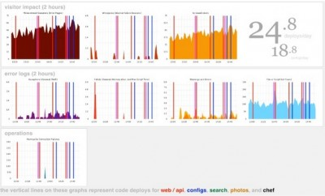
“If it moves, graph it.”
- Michael Rembetsy, Vice President Operations, Etsy

Slide 43
Lean Management makes our work better… and makes it feel better!
Improved Org Culture (Westrum)
WIP limits: drive improvement
Lean Management
IT Performance
Org Performance
Visualizations to monitor work
Monitoring to make business decisions
Decreased Feelings of Burnout

Slide 44

“I was trying to figure out why my team was working themselves to death but not getting anything done… By implementing WIP limits, we were able to focus on our work. Finishing work feels better than sprinting and feeling like a hero in the moment, because that’s only a moment.”
- Julia Wester, Development Manager for Turner Sports, Turner Broadcasting

Slide 45
Lean Management makes our work better… and makes it feel better!
Improved Org Culture (Westrum)
WIP limits: drive improvement
Lean Management
IT Performance
Org Performance
Visualizations to monitor work
Monitoring to make business decisions
Decreased Feelings of Burnout
Notes:
Also notice Culture… this should be familiar from the 2014 study

Slide 46
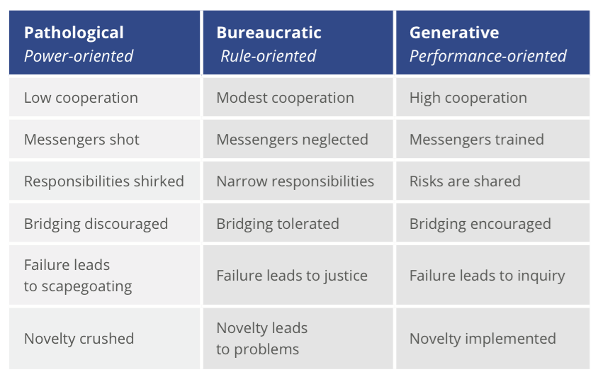
Organizational Culture
15%
52%
33%

Slide 47
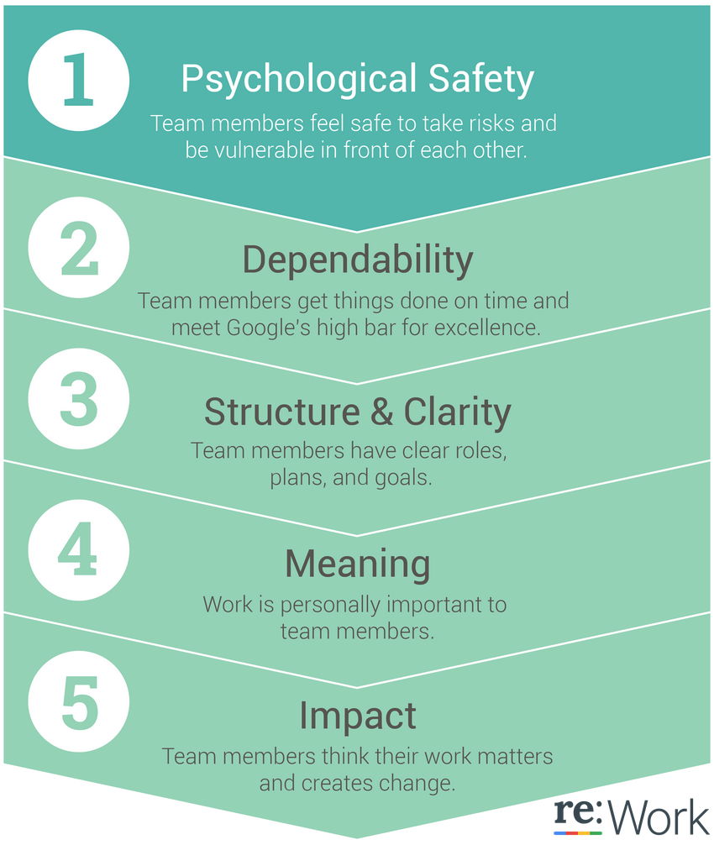
Google Team Performance
Surprise! No magical
formula for what makes
the perfect team

Slide 48
Intuit
“By installing a rampant innovation culture, we performed 165 experiments in the peak three months of tax season.
Our business result? Conversion rate of the website is up 50%. Employee result? Everyone loves it, because their new ideas can make it to market. ”
- Scott Cook, Intuit founder

Slide 49
Amazon
“I think building this culture is the key to innovation. Creativity must flow from everywhere. Whether you are a summer intern or the CTO, any good idea must be able to seek an objective test, preferably a test that exposes the idea to real customers. Everyone must be able to experiment, learn, and iterate.”
- Greg Linden

Slide 50
Job Satisfaction
Top Correlates
of Job Satisfaction
High-trust organizational culture
Climate of learning
Win-win relationships between ops, dev and infosec teams
Proactive monitoring and autoscaling
Use of version control for all production artifacts
Automated testing
Job satisfaction is the # 1 predictor of organizational
performance!

Slide 51
IT Does Matter
Times – and IT – have changed
DevOps is good for IT
DevOps is good for Organizations
And then some detail: What drives this change?
Tooling and automation (hint: Continuous Delivery)
Practice and process (hint: Lean Management practices)
Culture and communication

